Slide 1


Backup technology
By: Karamvir Randhawa

Slide 2
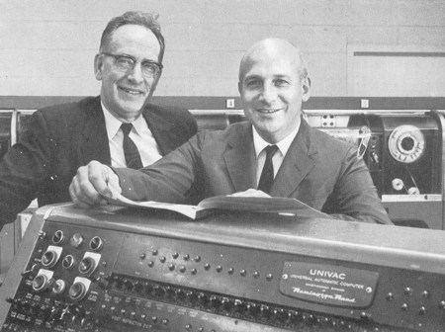
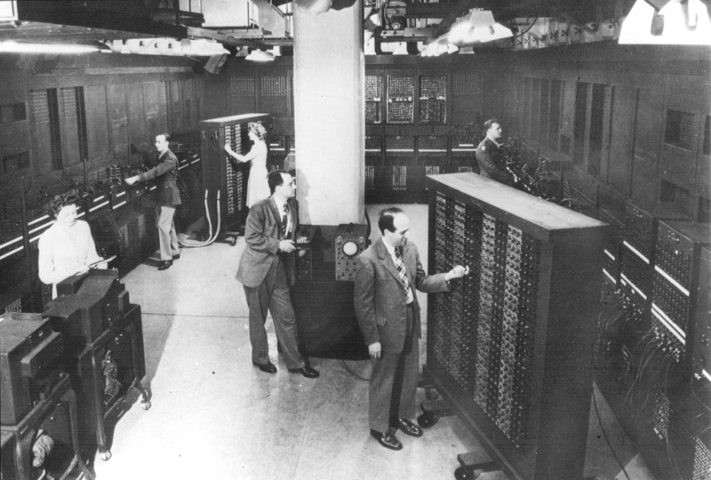
History of backup technology
The first appearance of backup technology was in 1951, they were called punch card backups
(Created by Mauchly and Eckret)
Punch card backups used vacuum tubes as main logic elements , rotating magnetic drums for internal storage of data and programs and punch cards to input and externally store data.

Slide 3
Comparison of back technology in the past vs now
Back up technologies in the 50’s to the late 70’s had a network back up storages
Back up technologies from the 80’s and to this day use online back up storages for better storage results

